Slide 1


ELI-NP, a new European facility
Livius Trache – IFIN-HH Bucharest-Magurele
Cyclotron Institute, Texas A&M University
IWNDT College Station, TX
Aug 19-22, 2013
with material from N.V. Zamfir, I.I. Ursu, ELI-NP workshops participants et al.

Slide 2
Summary
ELI-NP in Bucharest – presentation
Physics at ELI-NP
RIB production?!
Nuclear astrophysics at ELI-NP

Slide 3


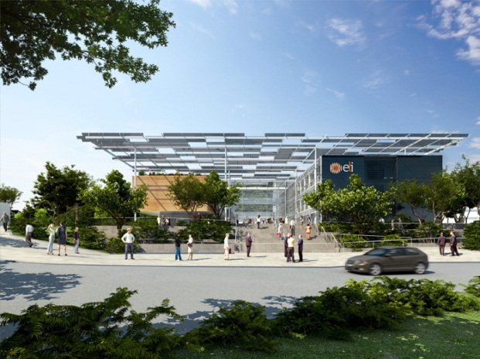
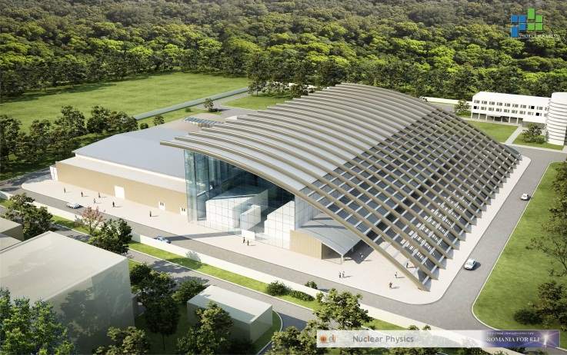
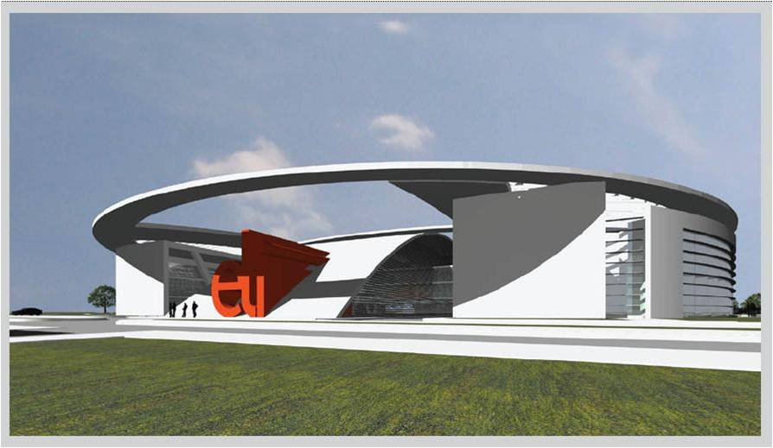
Extreme Light Infrastructure
2006 – ELI on ESFRI Roadmap
ELI-PP 2007-2010 (FP7)
  ELI-Beamlines (Czech Republic)
  ELI-Attoseconds (Hungary)
  ELI-Nuclear Physics (Romania)
Project Approved by the European Competitiveness Council (December 2009)
ELI-DC (Delivery Consortium): April 2010
Bucharest: June 2013 – civil constr start
3

Slide 4
Extreme Light Infrastructure - Nuclear Physics ELI – NP
@ IFIN-HH Bucharest-Magurele, Romania
Project leader: Nicolae-Victor Zamfir
Science white book: Dietrich Habs (LMU) et al
Scientific director: Sydney Gales
4

Slide 5
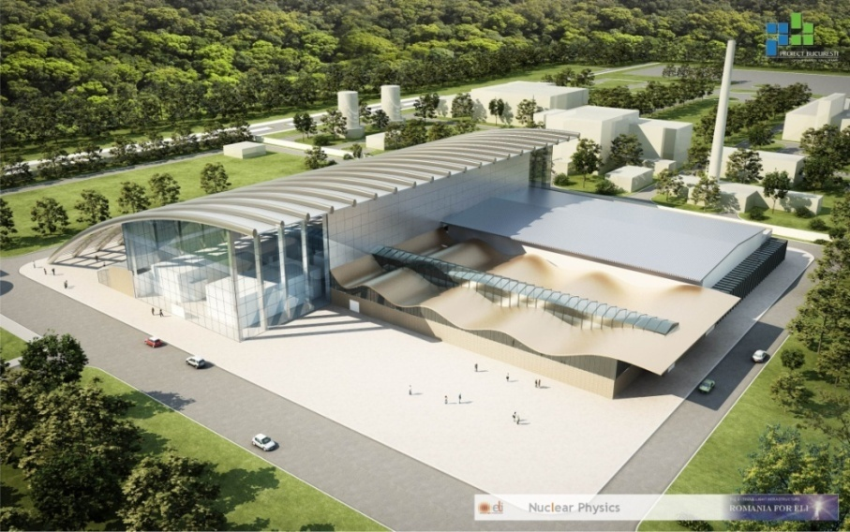
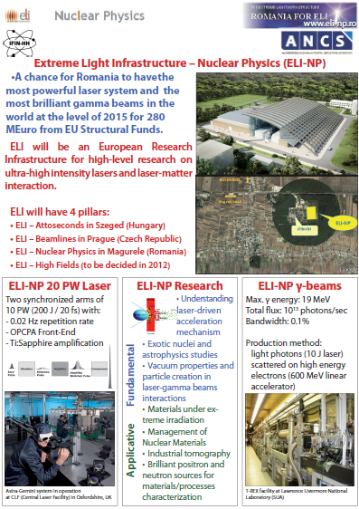
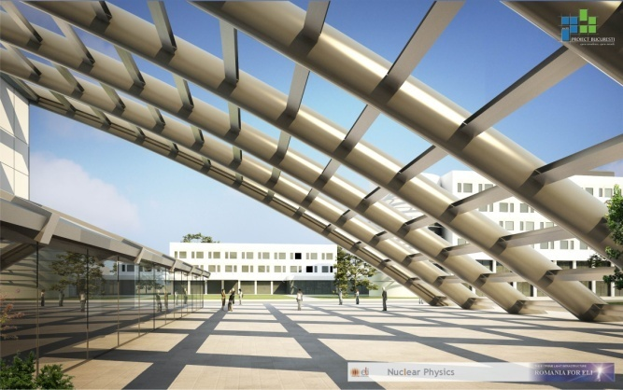
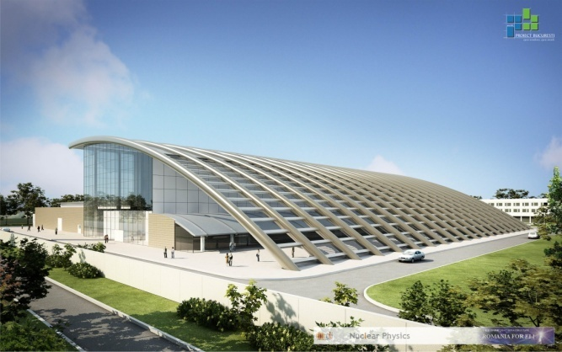

Slide 6
Bucharest – Magurele Physics Institutes
6

Slide 7
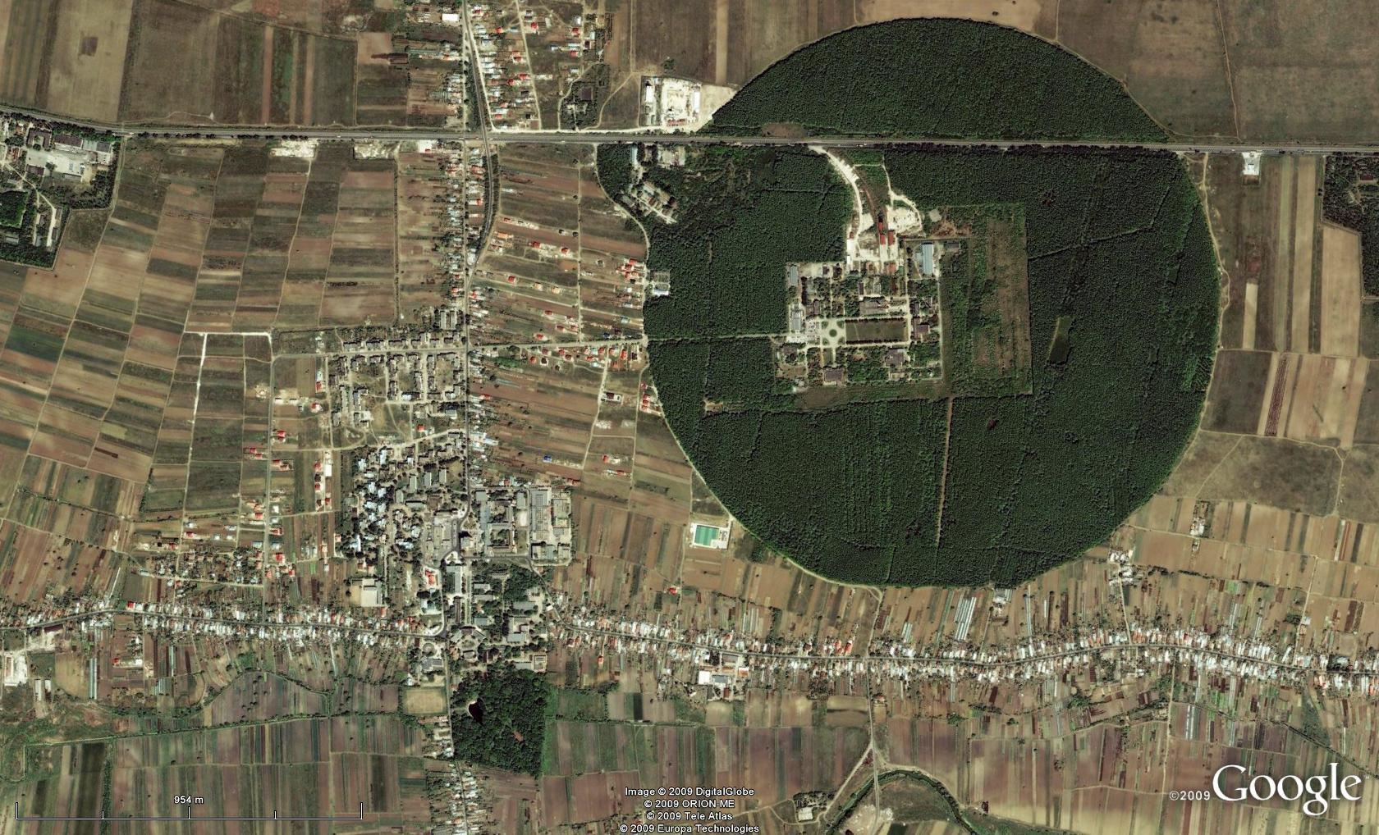
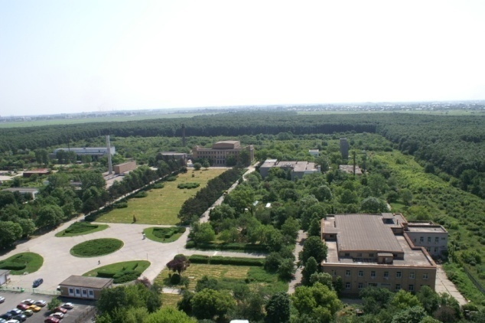
Bucharest-Magurele
National Physics Institutes
NUCLEAR
Tandem accelerators Cyclotrons
γ – Irradiator
Advanced Detectors
Biophysics
Environmental Phys.
Radioisotopes
BUCHAREST
ring rail/road
ELI-NP
Lasers
Plasma
Optoelectronics
Material Physics
Theoretical Physics
Particle Physics
ELI-NP

Slide 8
ELI-NP “Start-up” Activities
February-April 2010
Scientific case “White Book” (100 scientists, 30 institutions) (www.eli-np.ro)
approved by ELI-NP International Scientific Advisory Board
August 2010: Feasibility Study: 293 Meuro w/o VAT:
  Buildings: 60 M€
  Lasers: 60 M€
  Gamma Beam: 60 M€
  Beam Transport 20 M€
  Exp. equipments: 30 M€
August 2011 – March 2012: Technical Design
January 2012: Submission of the application to the E.C.
July 2012: Government Decision approving the construction of ELI-NP
September 2012: Approval of the application by the E.C.
June 14, 2013: Foundation stone ceremony

Slide 9
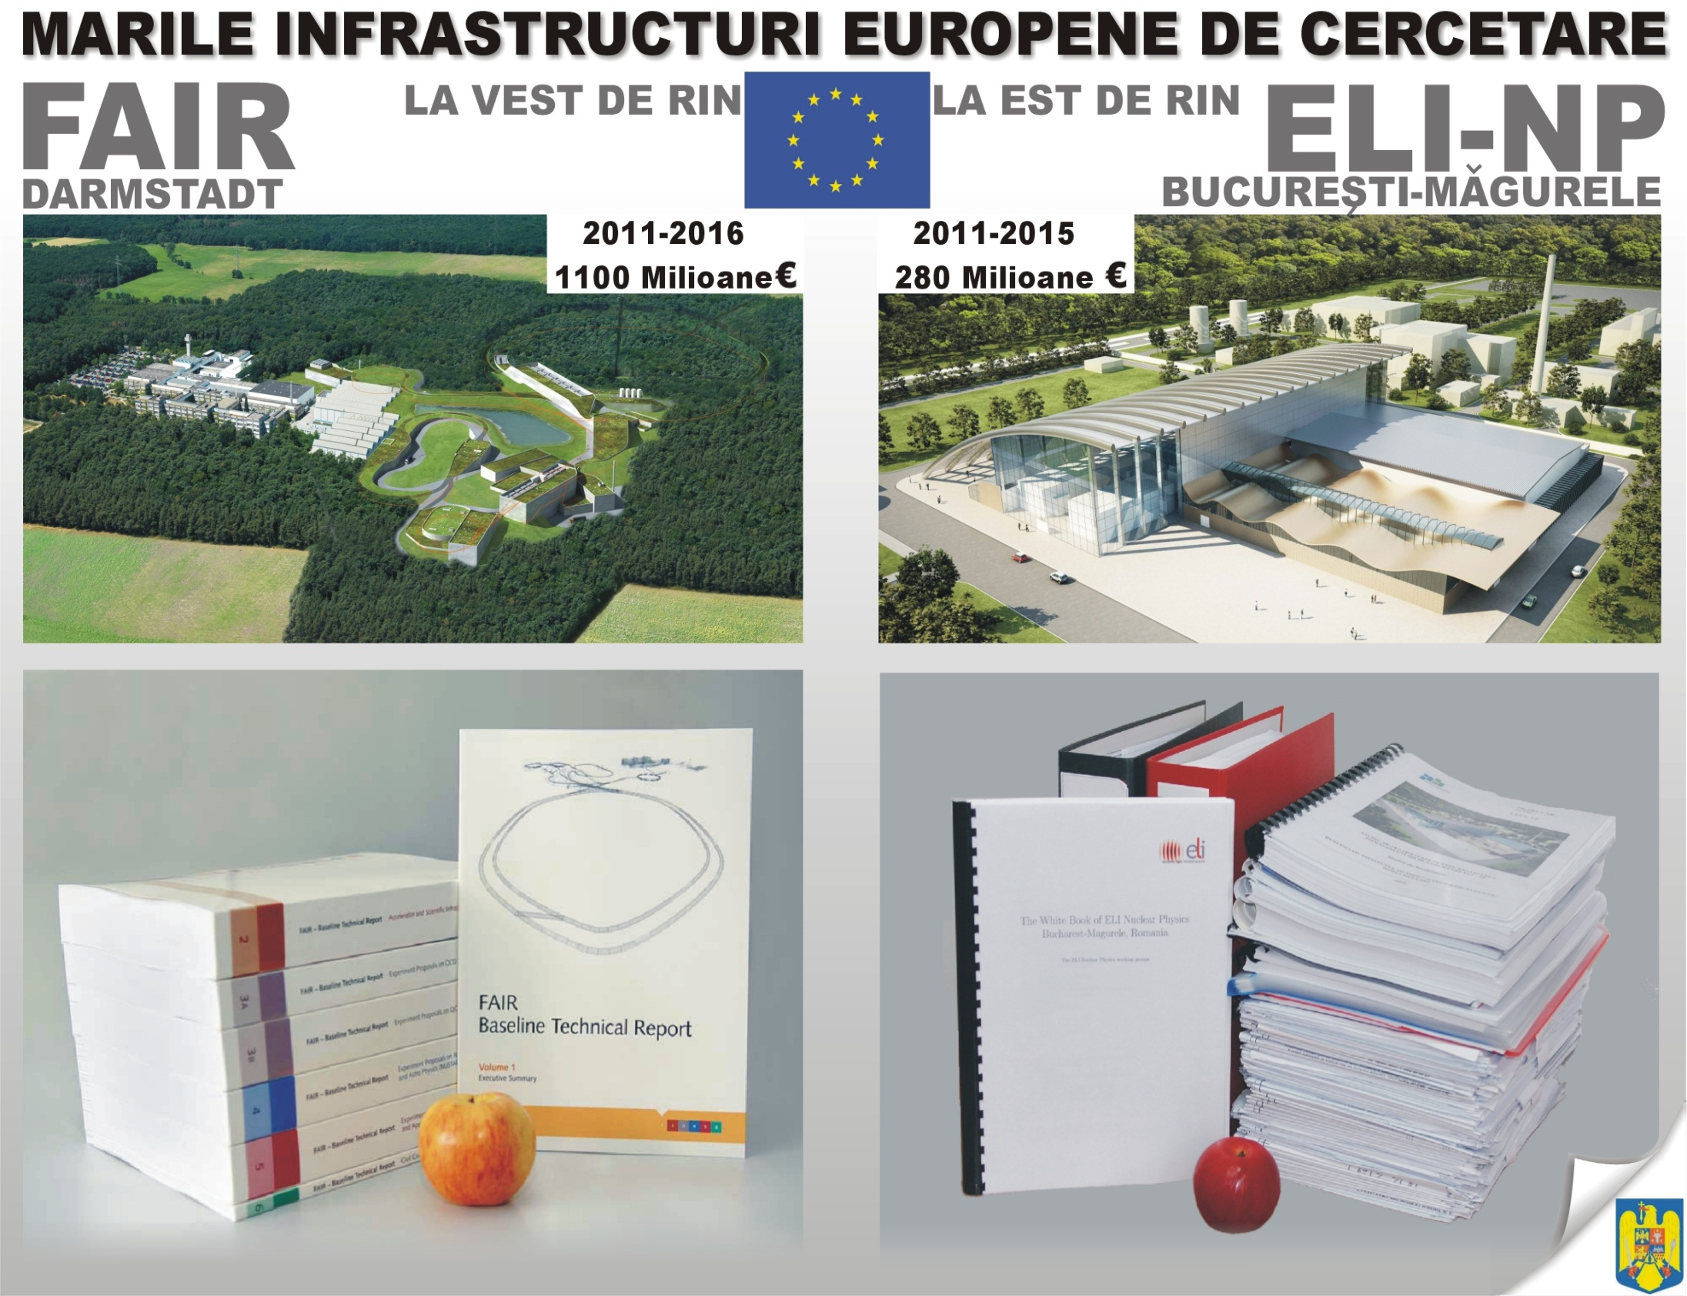

Slide 10
ELI-NP Next Steps
January 2012: Submission of the Application to DG-Regio
July 2012: Romanian Government Approval
November 2012: Tender Procedures start
June 2013- December 2014: Civil Construction
July 2015 : Lasers and Gamma Beam – Phase 1
December 2016 : Lasers and Gamma Beam - Phase 2
2013-2014: TDR for experiments
2015-2017: experimental set-ups
2018: beginning of operation

Slide 11
ELI-Nuclear Physics
“Extreme Light” :
two ultra-short pulse 10 PW APOLLON-type lasers
brilliant γ beam, up to 20 MeV, BW:0.1%
produced by Compton scattering of a laser beam
on a 700 MeV electron beam
Experiments
8 experimental areas, for gamma, laser, and gamma+laser

Slide 12
ELI-NP Facility Concept
High rep-rate laser experiments
0.1 – 1 PW
1PW block
Ti:Sapph
Flashlamp based
Oscillators
+OPCPA preamps
1PW block
Ti:Sapph
Flashlamp based
multi-PW block
Ti:Sapph
Flashlamp based
400mJ/ 10Hz/ <20fs
30J/ 0.1Hz/ <30fs
200J/ 0.01Hz/ <30fs
Multi-PW experiments
1PW block
Ti:Sapph
Flashlamp based
Oscillators
+ OPCPA preamps
1PW block
Ti:Sapph
Flashlamp based
multi-PW block
Ti:Sapph
Flashlamp based
Combined laser-gamma experiments
Laser
DPSSL 10J/120Hz
Gamma source
Compton based
Gamma/e- experiments
e⁻ accelerator
X-band
12

Slide 13
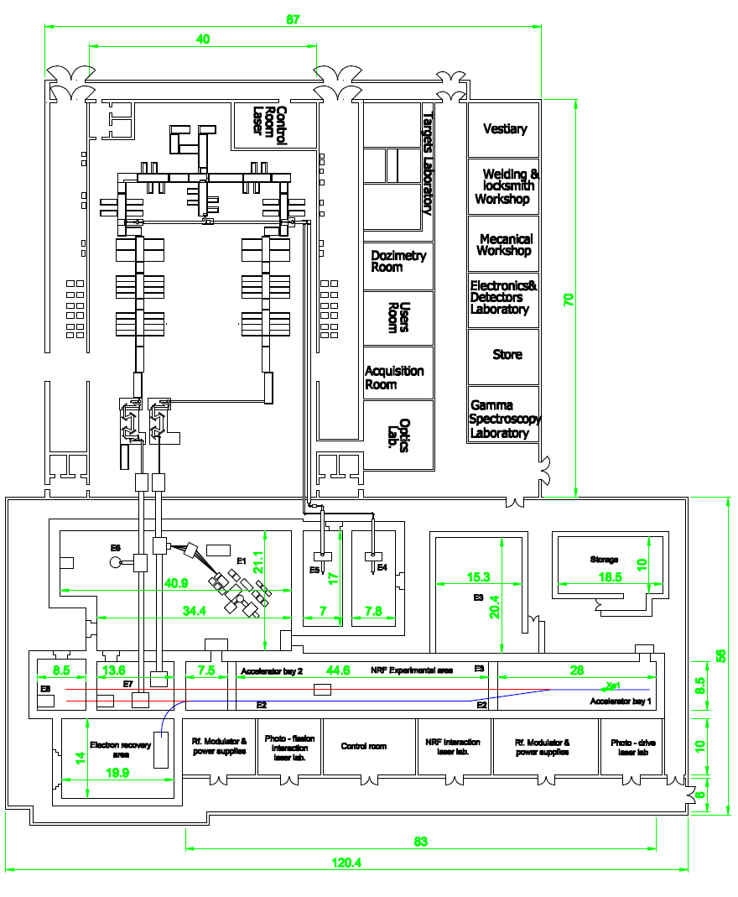
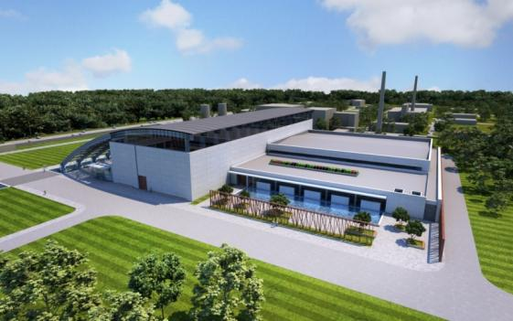
ELI-NP
Main buildings
Lasers
Gamma and experiments
Laboratories
Unique architecture

Slide 14
Chirped Pulse Amplification (CPA)
Idea: to stretch (and chirp) a fs pulse from an oscillator (up to 10,000 times), increase the energy by linear amplification, and thereafter recompress the pulse to the original pulse duration and shape
During amplification, the laser intensity is significantly decreased in order
- to avoid the damage of the optical components of the amplifiers;
- to reduce the temporal and spatial profile distortion by non-linear optical effects during the pulse propagation
14

Slide 15
ELI – Nuclear Physics Research
2
Nuclear Physics experiments to characterize laser – target interact.
Photonuclear reactions – most brilliant γ-beam, good resol.
Exotic Nuclear Physics and Astrophysics - complementary to other NP large facilities (FAIR, SPIRAL2, EURISOL).
Applications based on high intensity laser and very brilliant γ beams.
Complementary to the other pillars
ELI - Nuclear Physics
in ‘Nuclear Physics Long Range Plan in Europe’ as a major facility
15

Slide 16
ELI – NP Experiments (1)
Stand-alone High Power Laser Experiments
Nuclear Techniques for Characterization of Laser-Induced Radiations
Modelling of High-Intensity Laser Interaction with Matter
Stopping Power of Charge Particles Bunches with Ultra-High Density
Laser Acceleration of very dense Electrons, Protons and Heavy Ions Beams
Laser-Accelerated Th Beam to produce Neutron-Rich Nuclei around the N = 126 Waiting Point of the r-Process via the Fission-Fusion Reaction
RIB production
A Relativistic Ultra-thin Electron Sheet used as a Relativistic Mirror for the Production of Brilliant, Intense Coherent γ-Rays
Studies of enhanced decay of ²⁶Al in hot plasma environments
16

Slide 17
ELI – NP Experiments (2)
Laser + γ /e− Beam
Probing the Pair Creation from the Vacuum in the Focus of Strong Electrical Fields with a High Energy γ Beam
The Real Part of the Index of Refraction of the Vacuum in High Fields: Vacuum Birefringence
Cascades of e+e− Pairs and γ -Rays triggered by a Single Slow Electron in Strong Fields
Compton Scattering and Radiation Reaction of a Single Electron at High Intensities
Nuclear Lifetime Measurements by Streaking Conversion Electrons with a Laser Field.
17

Slide 18
ELI – NP Experiments (3)
Standalone γ /e experiments for nuclear spectroscopy and astrophysics
NRF: Nuclear Resonance Fluorescence
Study of pygmy and giant dipole resonances
Gamma scattering on nuclei
Fine-structure of Photo-response above the Particle Threshold: the (γ ,α), (γ,p) and (γ ,n)
Dipole polarizability with high intensity, monoenergetic MeV γ-radiation for the evaluation of neutron skin
Nuclear Transitions and Parity-violating Meson-Nucleon Coupling
Multiple Nuclear Excitons
Measuring Narrow Doorway States identified by specific (γ, f), (γ, p), (γ, n) Reactions
Precision Tests of Fluctuating Quantities in Nuclear Physics: Random-Matrix-Theory and Quantum Chaos
Neutron Capture Cross Section of s-Process Branching Nuclei with Inverse Reactions
Measurements of (γ, p) and (γ, α) Reaction Cross Sections for p-Process Nucleosynthesis
High Resolution Inelastic Electron Scattering (e,e’)
18

Slide 19
ELI – NP Experiments (4)
Applications
Laser produced charge particle beams may become an attractive alternative for large scale conventional facilities
Laser-driven betatron radiation - gamma beams
High Resolution, high Intensity X-Ray Beam
Intense Brilliant Positron-Source: 10⁷e⁺/[s(mm mrad)² 0.1%BW]
Radioscopy and Tomography
Materials research in high intensity radiation fields
Applications of Nuclear Resonance Fluorescence
19

Slide 20
M. Smith & E. Rehm
3
+ fission
barriers ?!
mass, T_{1/2}
resonances
site, path?!
mass, T_{1/2}
Dir+reson
Two big problems:
- reactions in stars involve(d) radioactive nuclei ⇒ use RNB
- very small energies and very small cross sections ⇒indirect methods

Slide 21
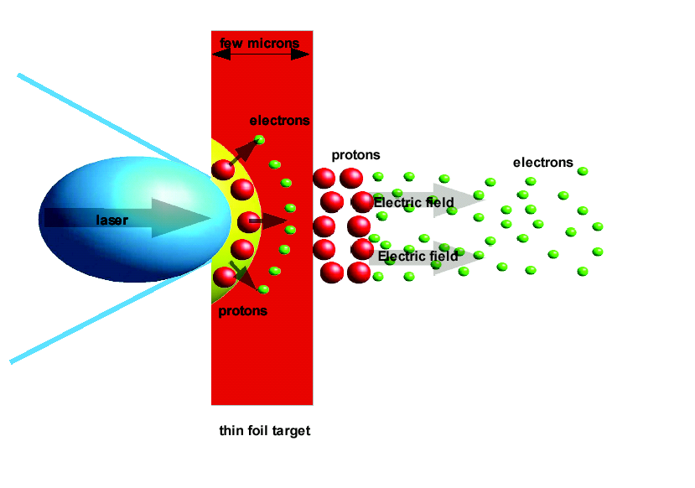
Target Normal Sheath Acceleration (TNSA)
Secondary
target
Secondary radiations
- electrons bremssstrahlung
- gamma rays, neutrons
Primary radiations
Electrons are expelled from the target due to the ponderomotive force
Heavy ions are accelerated in the field created by the electrons
E~I_{laser}^{1/2}
S.C. Wilks et al., Phys. Plasmas 8, 542 (2001).

Slide 22
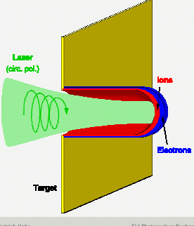
Radiation Pressure Acceleration RPA
Electrons and ions accelerated
at solid state densities 10²⁴e cm⁻³
(Classical beam densities 10⁸e cm⁻³)
E~ I _{laser}

Slide 23
RIBs. Indirect methods for NA. Steps at ELI-NP
RIB production: mechanism → study production w. spectrometer(s), w. gas-filled separator ?!
RIB separation – momentum achromat + velocity filter ?!
Secondary beam preparation – Filters?! Reacceleration?!
Secondary reaction – target station
Detection – complex array(s): gas, Si, γ, PID, position sensitive, …
Extract NS information - difficult theory calc: structure and reactions
(Normalization) - may need absolute values from elsewhere
NA interpretation - theory support again!
Comparison with direct measurements/ normalization – develop strong program of direct measurements at the 3 MV tandetron
L. Trache, ELI-NP workshop, Bucharest, June 25-26, 2013

Slide 24
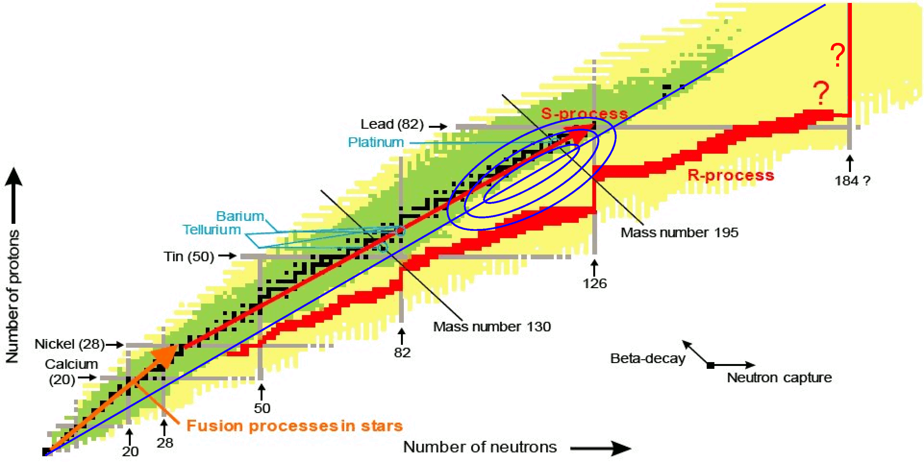
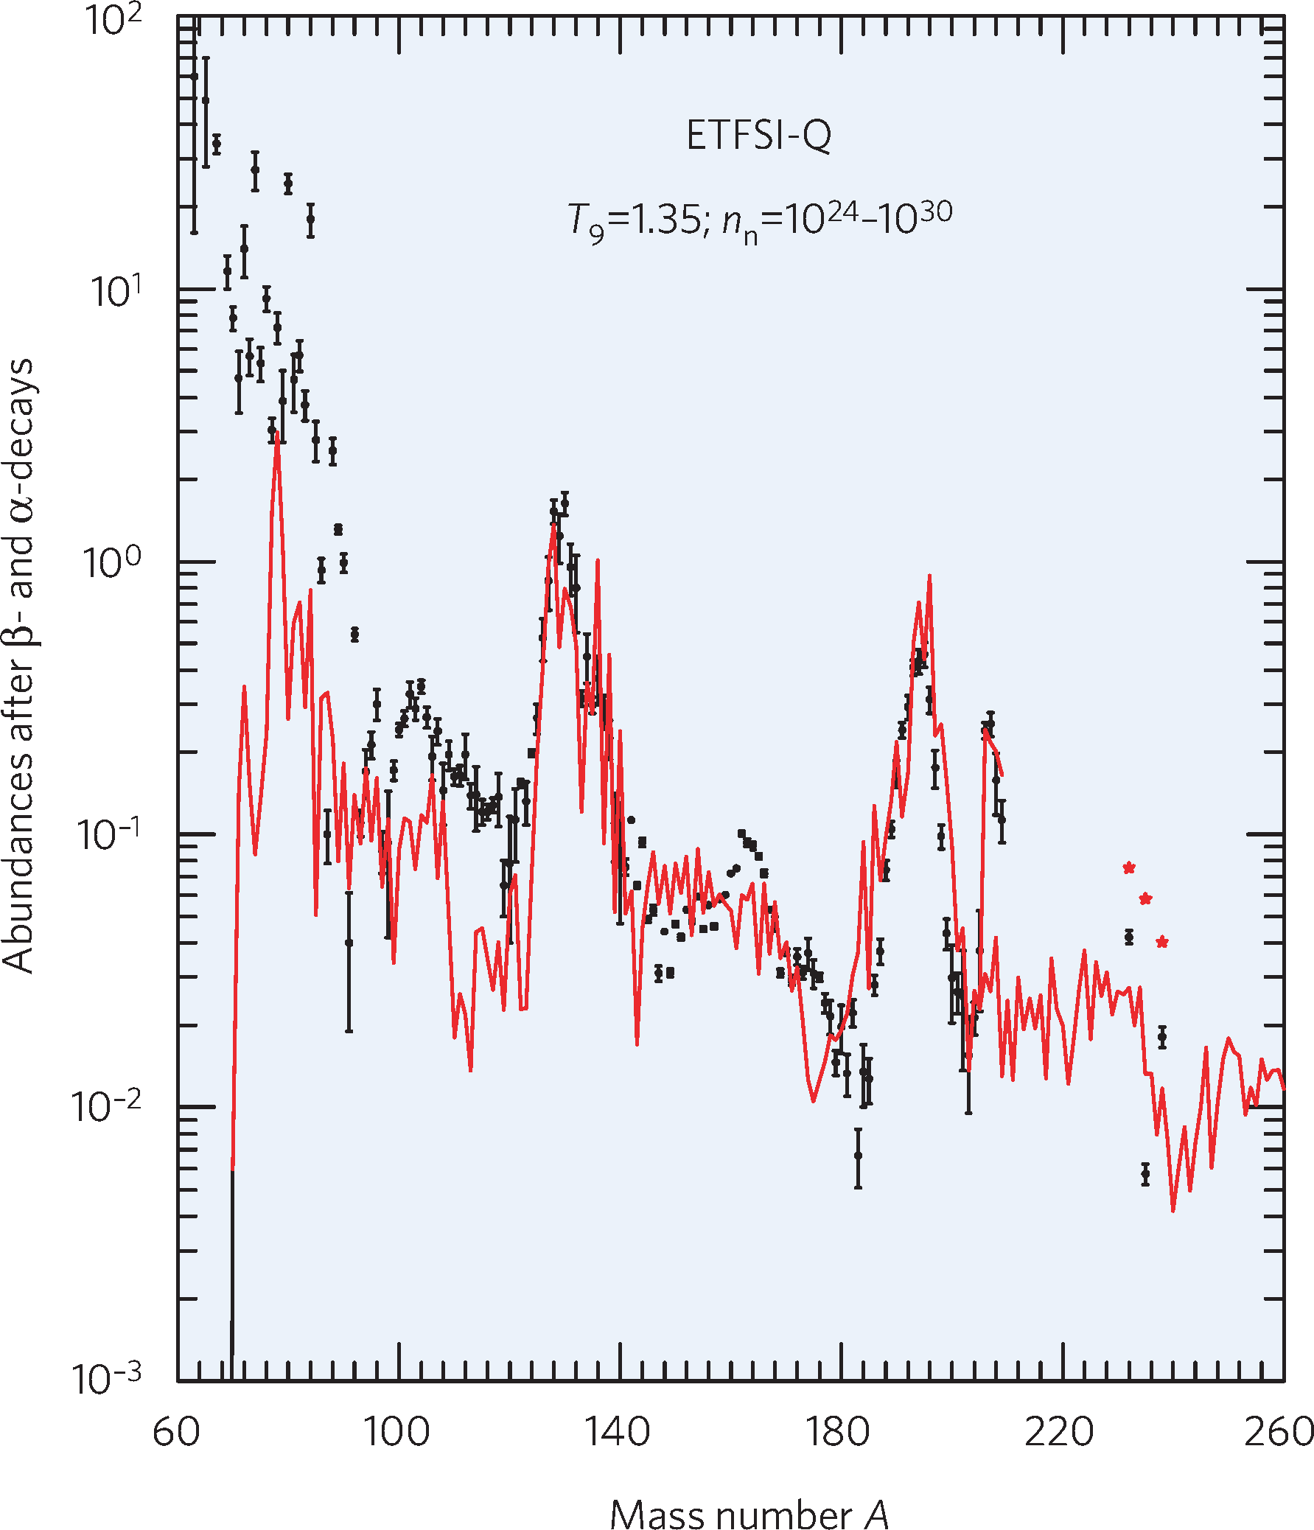
Production of Extremely Neutron-Rich Isotopes
LoI: P. Thirolf et al. (LMU Munich)
motivation:
- exploit ultra-dense laser-accelerated ion beams for novel nuclear
reaction mechanism: “fission-fusion”
- produce extremely n-rich species towards N=126
- expected production range:
Au, Pt, Ir,Os
- waiting point N=126: bottleneck for nucleosynthesis
of actinides
- last region of r process ‘close’ to stability

Slide 25
Exp. Scheme for “Fission-Fusion”
Production target
Reaction target
²³²Th: ~ 50μm
²³²Th: 560 nm
Fission
fragments
< 1 mm
conventional stopping:
Fusion products
CD₂: 520 nm
high-power, high-contrast laser:
150-300 J, ~32 fs (8.5-17 PW)
CH₂ ~ 70 μm
1.2.10²³ W/cm²
²³²Th: ~ 5 mm
focal diam. ~ 3 μm
²³²Th: 560 nm
Fission
fragments
< 1 mm
collective stopping:
Fusion products
CD₂: 520 nm
D. Habs, PT et al., Appl. Phys. B 103, 471 (2011)

Slide 26
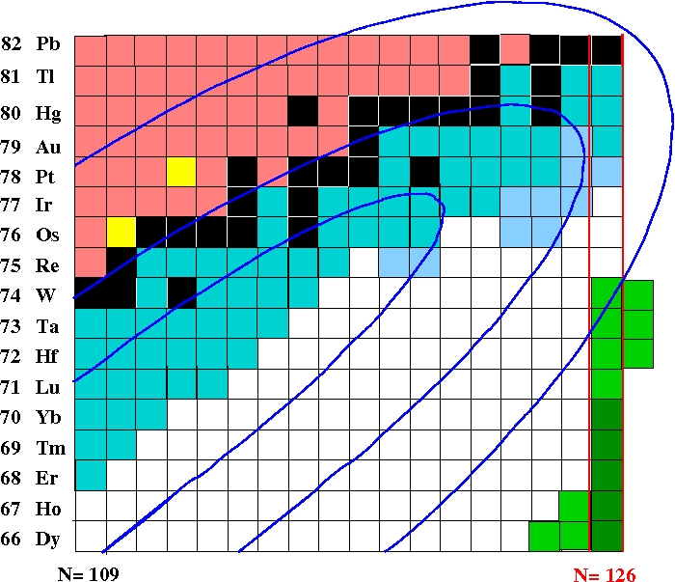
Towards N=126 Waiting Point
r process path:
- known isotopes ~15 neutrons away from r-process path (Z≈ 70)
0.001 σ_{fisfus}
measure:
- masses, lifetimes, structure
- lifetime measurements:
already with ~ 10 pps
visions:
test predictions: r process
branch to long-lived (~ 10⁹ a)
superheavies (Z≥110)
→ search in nature ?
improve formation predictions
for U, Th
recycling of fission fragments
in r-process loops ?
x
0.1
0.5
key
nuclei

Slide 27

Q: Can we put a point here?!
What color?!
TRIUMF,
Canada
NSCL/FRIB
USA
GANIL
France
GSI/FAIR
Germany
Texas A&M
USA
RIKEN
Japan
IFUSP
Sao Paulo,
Brazil
ISOL (currently)
ISOL (future)
In-Flight (currently)
In-Flight (future)
27

Slide 28
Laser-induced “stellar plasma”?!
4
Short-lived plasmas w conditions similar to stellar plasmas
  Characterization
  Nuclear astrophysics: capture reactions on excited states – very imp for quantitative descr of stellar nucleosynthesis, but out of the range of our current experimental possibilities. Can we…?!!
  How?! What setups?!
L. Trache, ELI-NP workshop, Bucharest, June 25-26, 2013

Slide 29
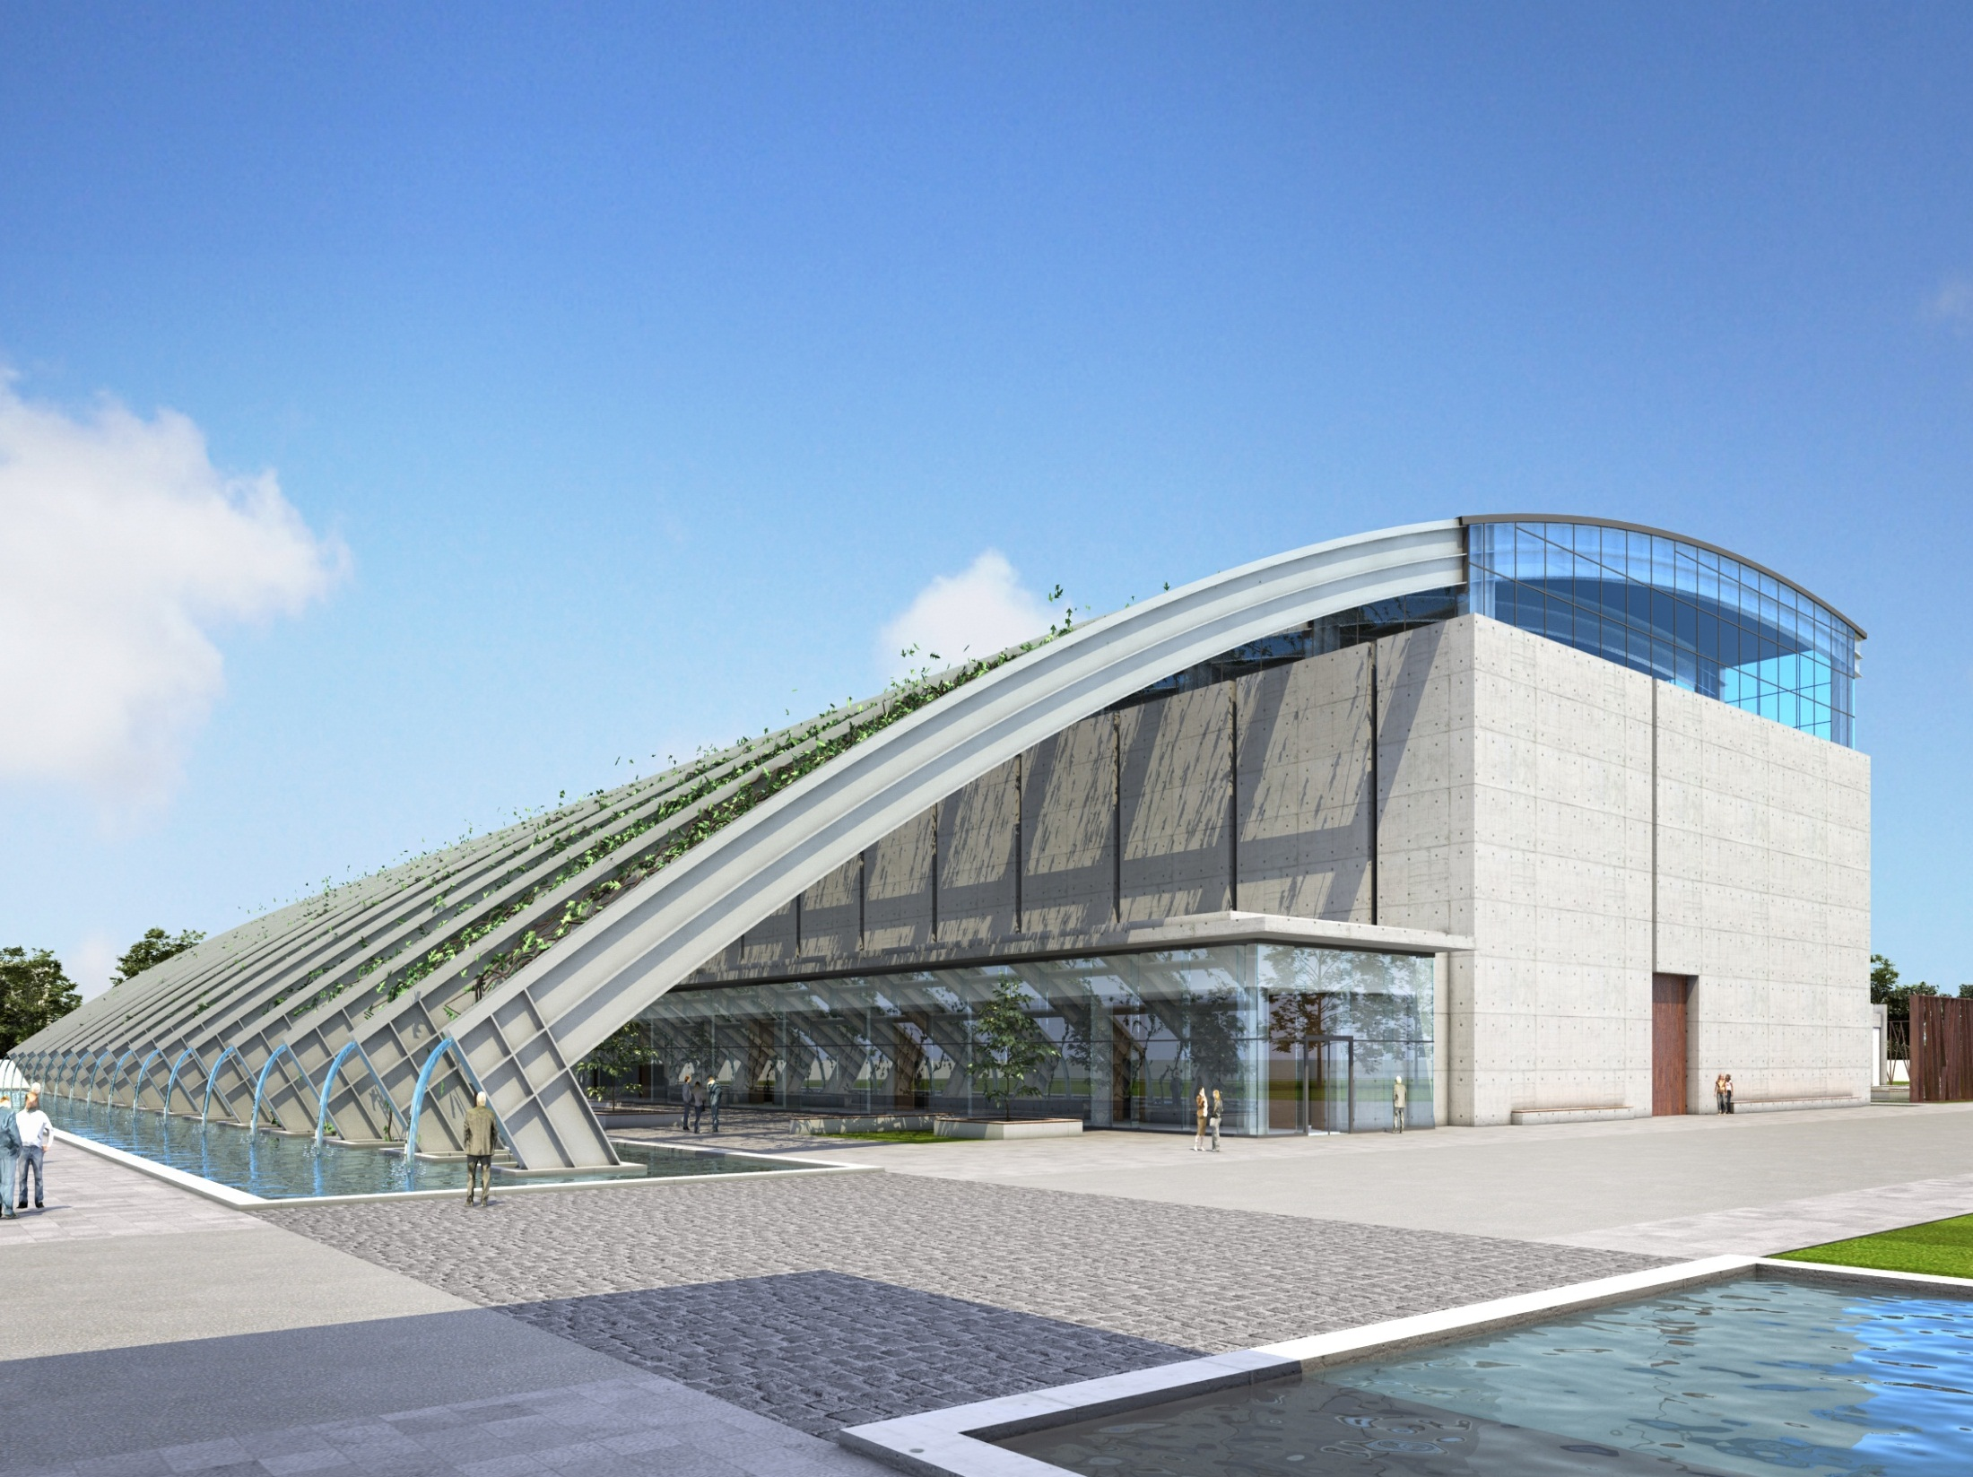
European facility
Open for cooperations
We are hiring!
Thank you!

